Slide 1
SMS-Service in Telephony
Minh Pham

Slide 2
Agenda
Overview
Telephony Forwarding SMS messages
Architecture
Data flow
HLD sequence
Explaining Functions
Log reading
RIL Forwarding SMS messages
Architecture
Data flow
HLD sequence
Explaining Functions
Log reading

Slide 3
Overview
http://collab.lge.com/main/display/~minh.pham/1.+Overview+of+Telephony

Slide 4
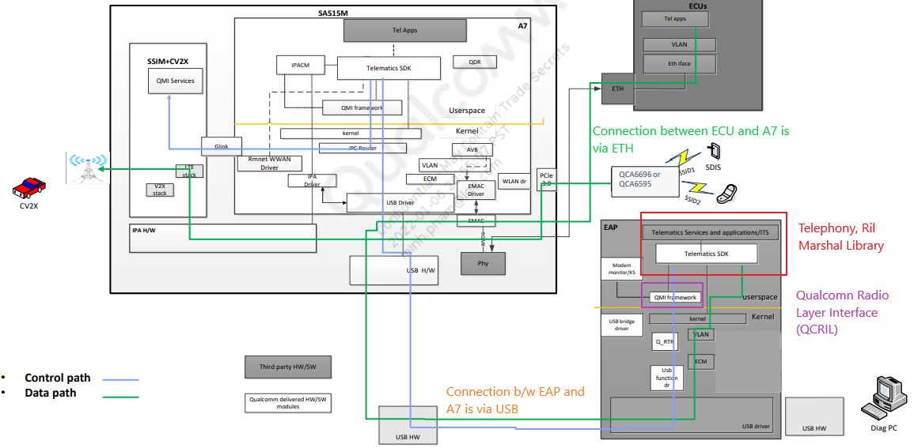
High Level view of SA515 System with External AP and ECUs:

Slide 5
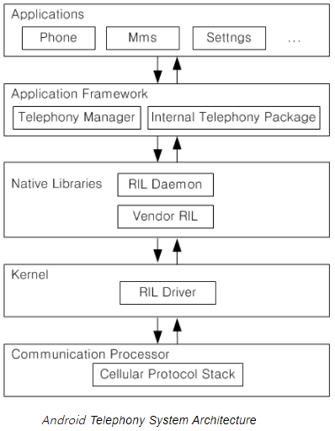
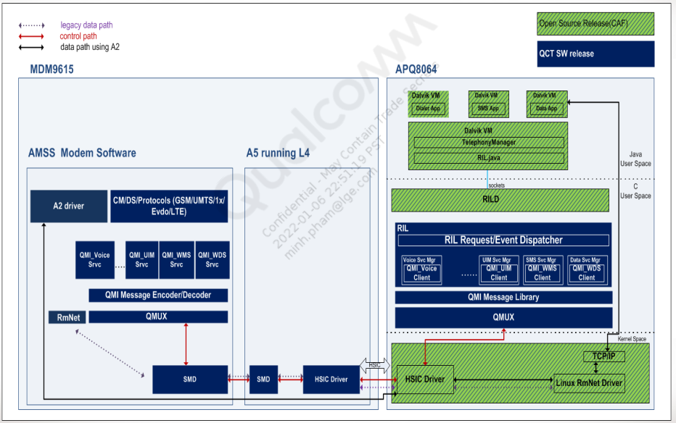
High Level View of Telephony and QCRIL:
Telephony Framework (Telephony Manager + Internal Telephony Package): Telephony Framework provides telephony services such as voice calls, short message (SMS), data services, and network services.
RIL Daemon: processes all requests from the Telephony Framework and handles over to Vendor RIL
Vendor RIL (or Qualcomm RIL QRILD): sends information such as a response to a request from the Telephony Framework or Network Status.

Slide 6
Telephony Forwarding SMS messages
http://collab.lge.com/main/display/~minh.pham/2.+Telephony+forwarding+SMS+messages

Slide 7
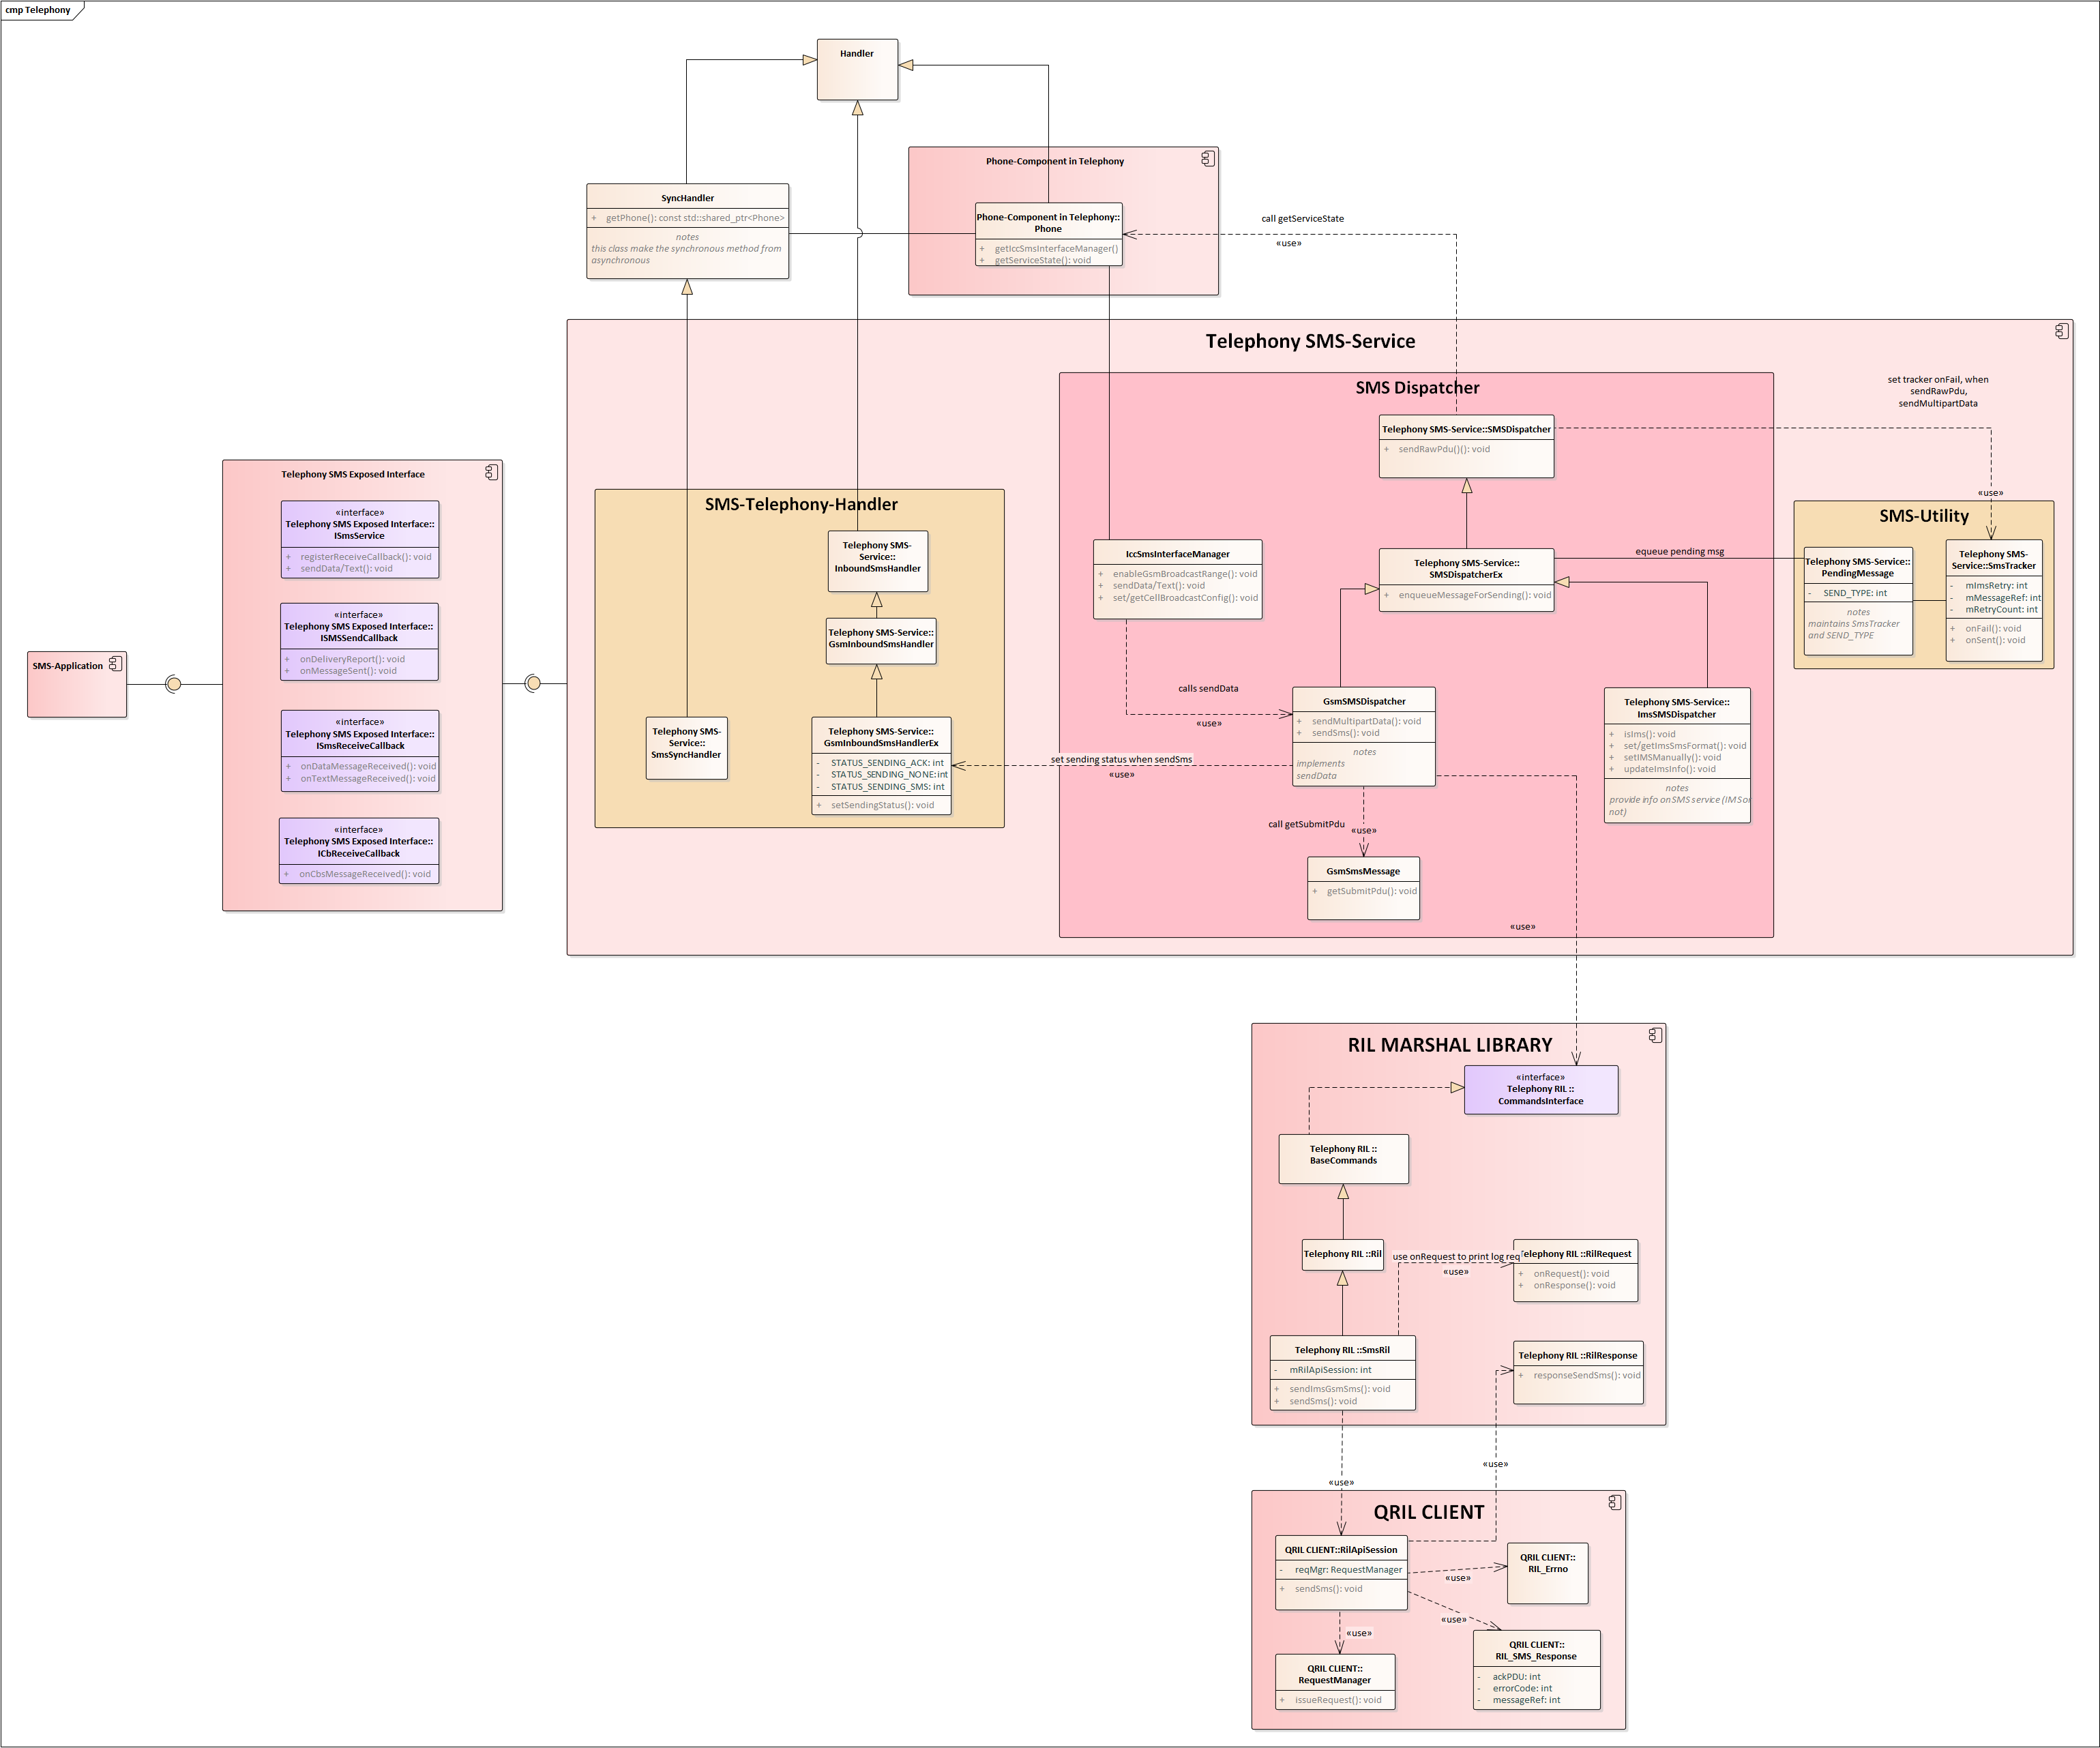
Architecture

Slide 8
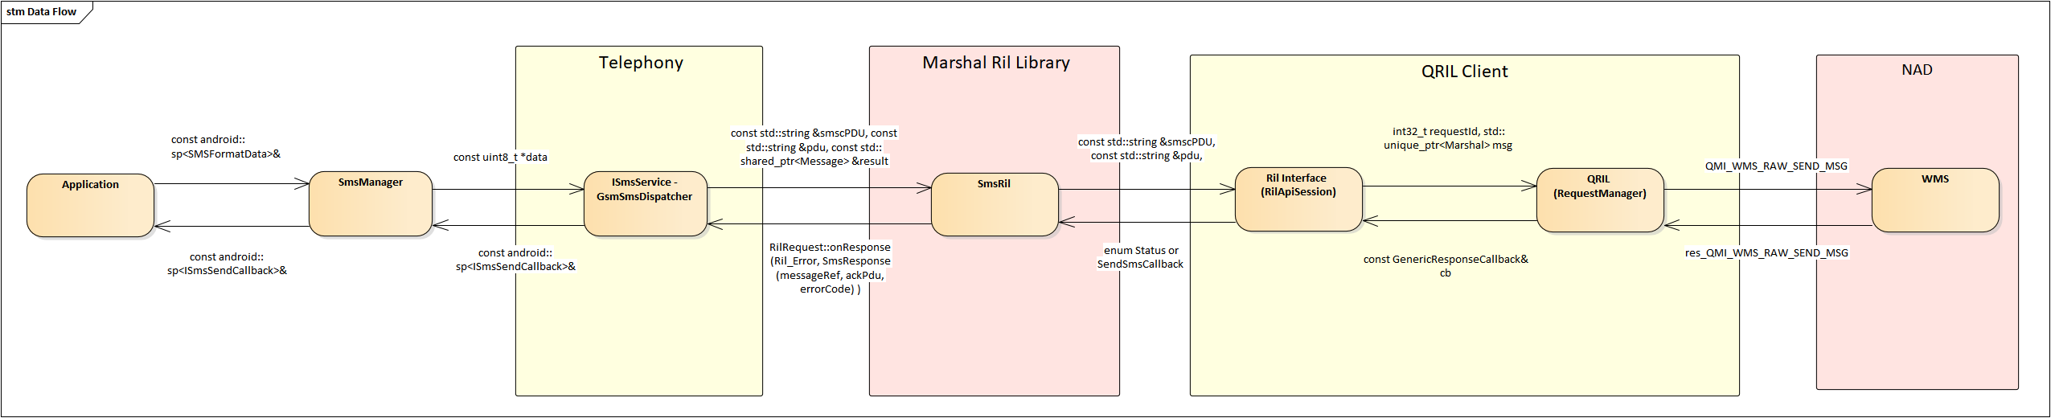
Data Flow
Data flow represents the input arguments for main API that were called at each module

Slide 9
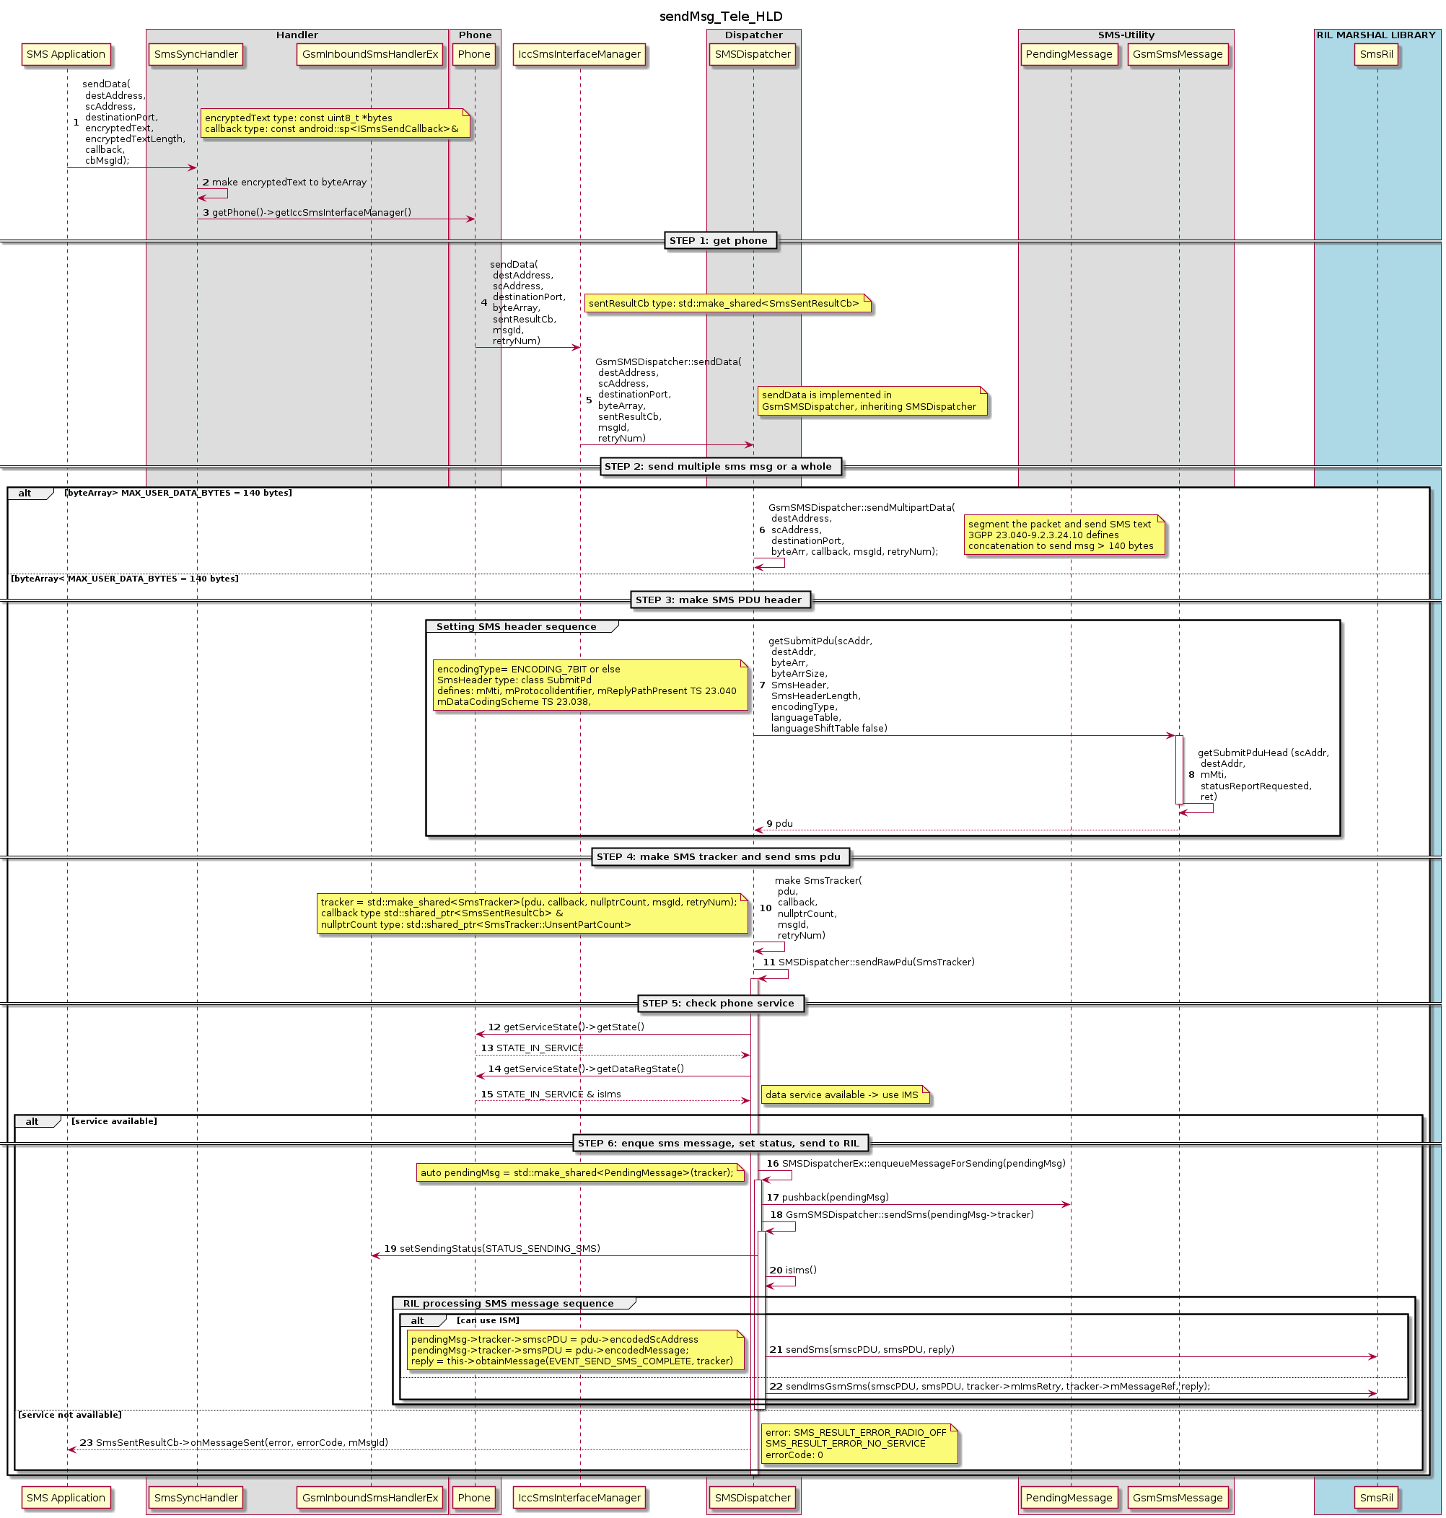
HLD sequence

Slide 10
Explaining Functions sendMultiPartPDU()
Notes:
Input means the arguments that this function takes and processes.
Destination means the next module and API that this function will call.
Output means the parameter that this API will pass to the next function/modules.
Return means the callback, returns by pointer/reference or direct return by value of this function
Step 6: sendMultiPartPDU()
 | Description
input | const string &destAddr, : destination Number const string &scAddr, int32_t destPort, : source Number std::shared_ptr<ByteArray> &byteArr, : sms message data int32_t msgId, : message ID const int32_t retryNum : number of retry if send fail
output | UDH field: (User Data Header) included reference Number, sequence Number, message count and boolean isEightBits Segmented SMS data message: has only 137 bits
destination | call GsmSmsMessage::getSubmitPdu(scAddr, destAddr, /*destPort,*/ segData->getBytes(), static_cast<uint32_t>(segData->size()), udh, udhLen, false);

Slide 11
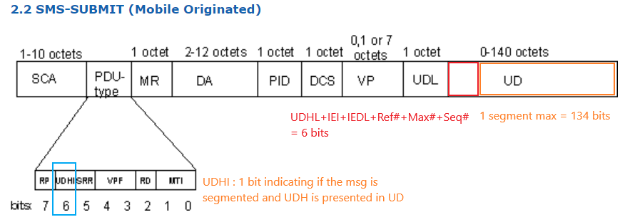
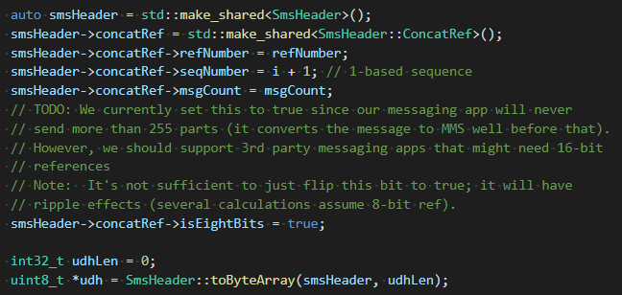
Explaining Functions sendMultiPartPDU()
Step 6: sendMultiPartPDU()
UD field: 134 bytes
UDH field: 6 bytes

Slide 12
Explaining Functions getSubmitPduHead()
Step 8: getSubmitPduHead
 | Description
input | const std::string &scAddress, const std::string &destinationAddress, uint8_t mtiByte, bool statusReportRequested, std::shared_ptr<GsmSmsMessage::SubmitPdu> ret
output | ByteArrayOutputStream[(MAX_USER_DATA_BYTES + 40)] that has the following information: UDHI = 1 if message was segmented and delivered via multiPDU MTI = 1 if (SMS-SUBMIT, sending message) TP-Status-Report-Request bit = 1 if TP-Status-Report-Request Message Ref = 0 Destination Address in BCD Protocal Identifier (PID) = 0
destination | local variable for GsmSmsMessage::getSubmitPdu(
Return | ByteArrayOutputStream[(MAX_USER_DATA_BYTES + 40)]

Slide 13
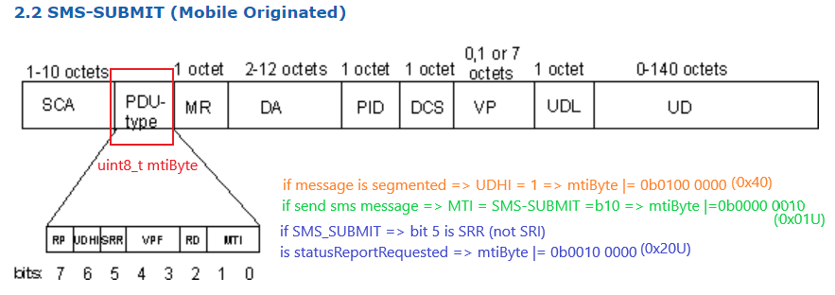
Explaining Functions: getSubmitPduHead()
Step 8: getSubmitPduHead

Slide 14
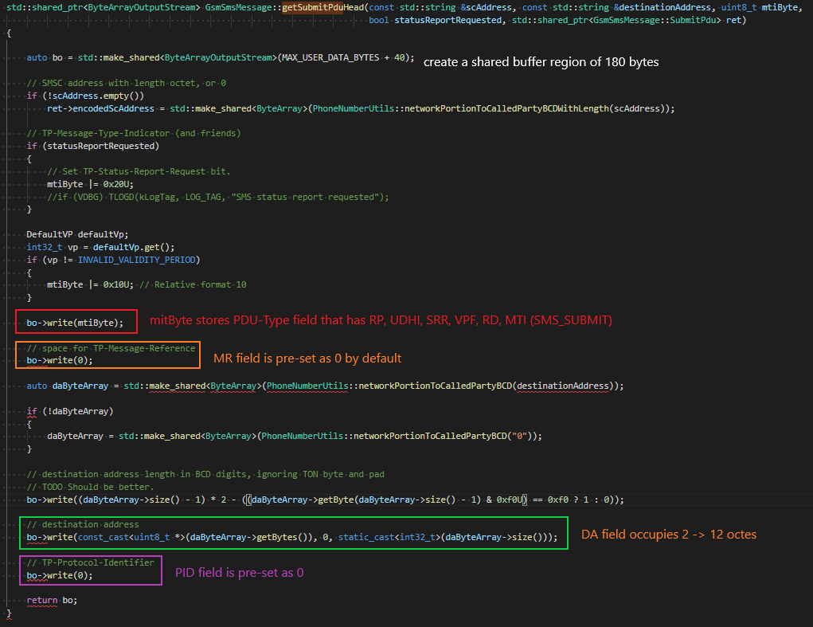
Explaining Functions: getSubmitPduHead()
Step 8: getSubmitPduHead

Slide 15
Explaining Functions getSubmitPDU ()
Step 7: getSubmitPDU
 | Description
input | const std::string &scAddress, const std::string &destinationAddress, const std::string &message, bool statusReportRequested, const uint8_t *header, uint32_t headerLen, int32_t encoding, int32_t languageTable, int32_t languageShiftTable)
output | GsmSmsMessage::SubmitPdu
destination | SmsDispatcher for SmsDispatcher::sendSms()
Return | shared_ptr<GsmSmsMessage::SubmitPdu>

Slide 16
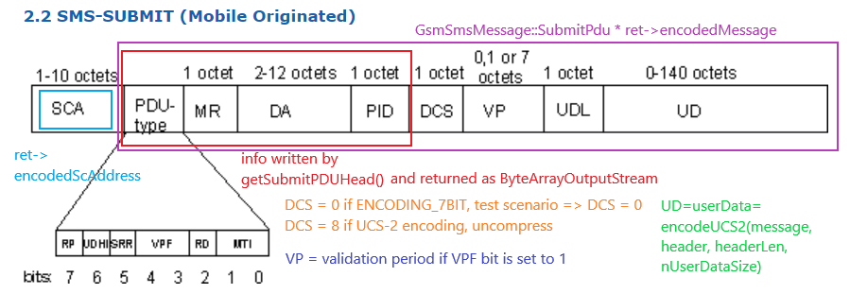
Explaining Functions getSubmitPDU ()
Step 7: getSubmitPDU

Slide 17
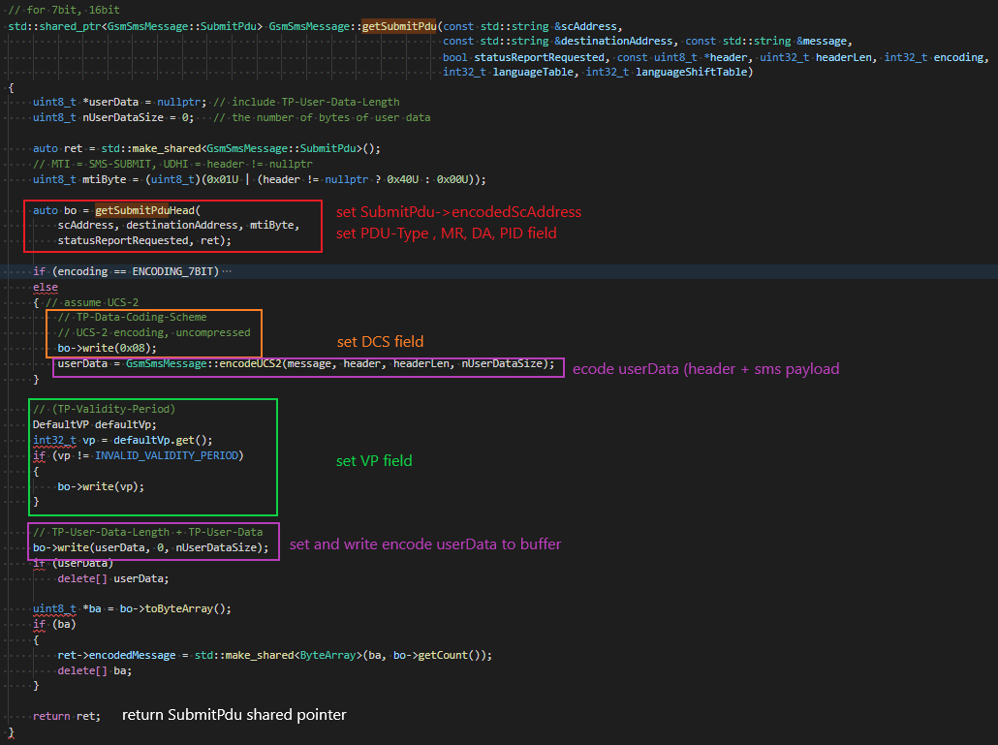
Explaining Functions getSubmitPDU ()
Step 7: getSubmitPDU

Slide 18
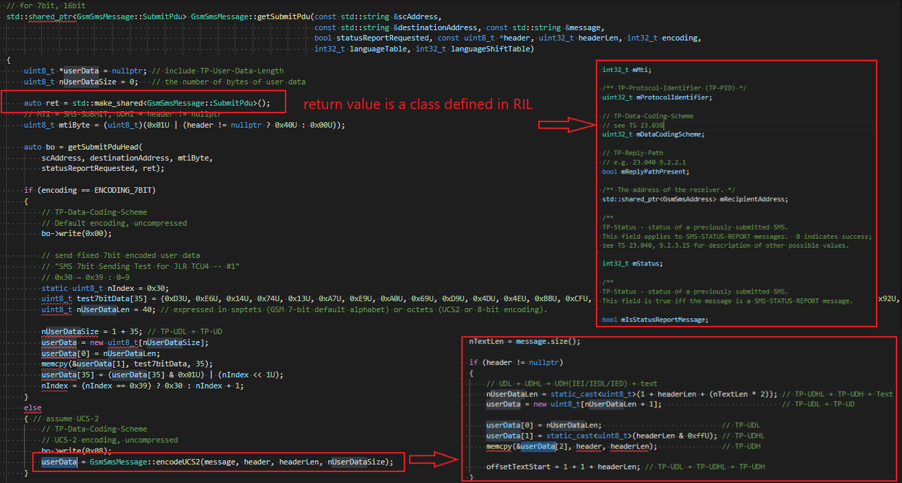
Explaining Functions getSubmitPDU ()
Step 7: getSubmitPDU

Slide 19

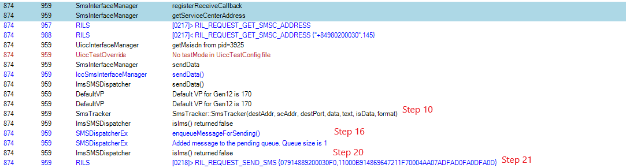

Telephony Log Reading (data/logger/radio.log)
Step 1-20: Telephony Receives request from Sms_Mgr (Wave, Toyota project)
If sending is fail due to No Service:
Step 1-20: Telephony Receives request from Sms_Mgr (Gen12 project)
Step 23: EVENT_SEND_SMS_COMPLETE

Slide 20
RIL forwarding SMS messages
http://collab.lge.com/main/display/~minh.pham/2.1+RIL+procedure+with+MARSHAL+RIL+FRAMEWORK

Slide 21
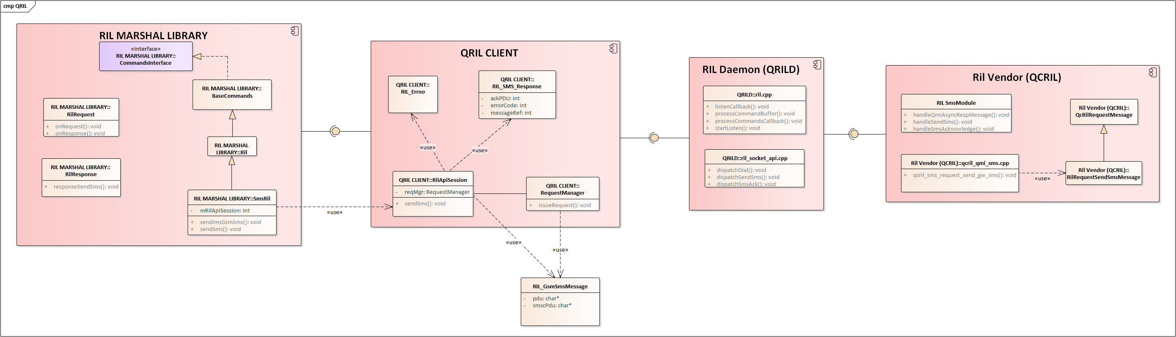
Architecture

Slide 22
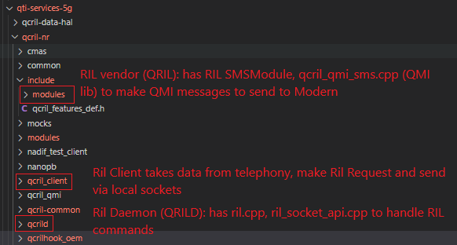
Ril Marshal library vs Ril Daemon vs Vendor Ril
 | Solicited cmds | Unsolicited cmds
How it is delivered | associated with TokenId or RequestId | associated with events
What QRIL will do | QRIL calls API to execute operation or dispatch internal commands QRIL calls sendResponse() when operation is finished | Qril sends unsolicitedResponse() when finished.
QRIL APIs | dispatchDial dispatchSendSms | notifyClientServerIsReady

Slide 23
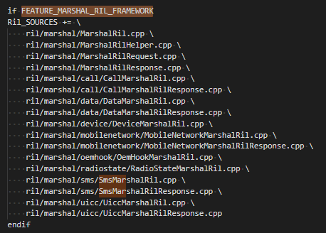
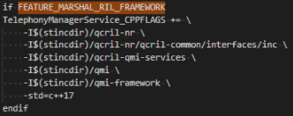

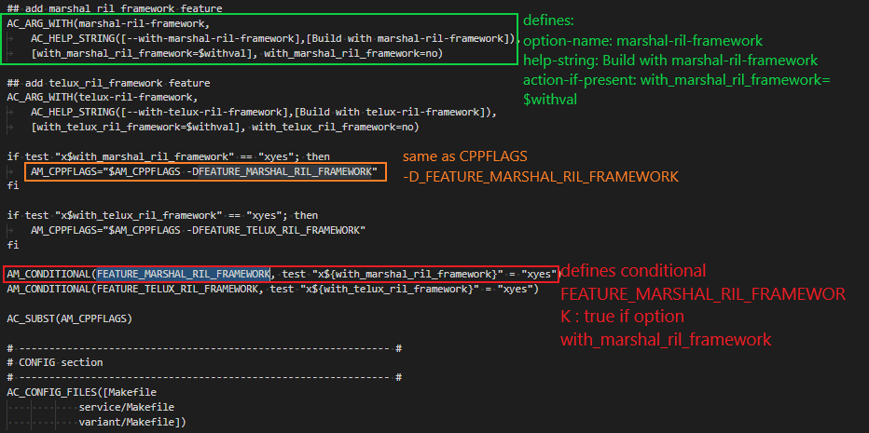
How to include Marshal Rill Framework library in Telephony build:
usage of Marshal Ril Framework is defined by build option: FEATURE_MARSHAL_RIL_FRAMEWORK
Build option in Makefile.am list the files to be included in build:
Include directory to Qualcomm QRIL library:
Included built qril client library:
Included built qril client library:
Build option defined the features FEATURE_MARSHAL_RIL_FRAMEWORK is in configureac.add:

Slide 24
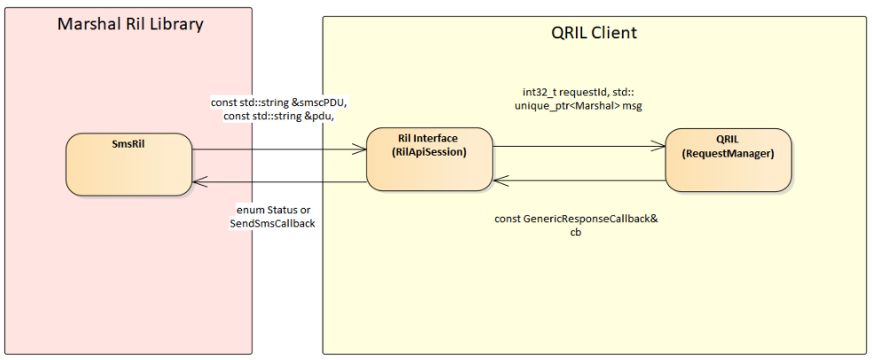
Data Flow Marshal Ril Library <-> QCRIL Client
Data flow represents the input arguments for main API that were called at each module

Slide 25
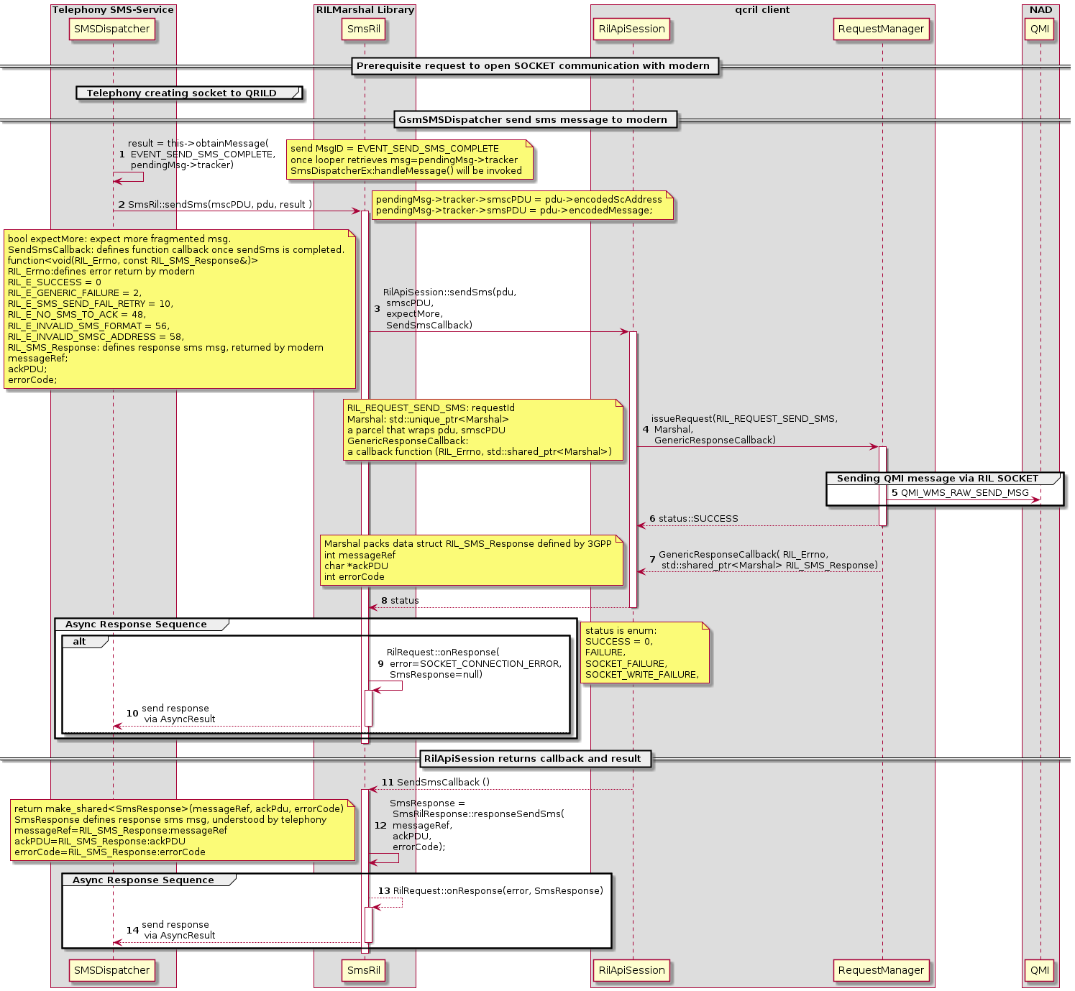
HLD sequence Telephony -> RIL Marshal Lib -> QCRIL client

Slide 26
Explaining functions
Step 2: SmsRil::sendSms(mscPDU, pdu, result)
 | descriptions
input | const string &smscPDU , const string &pdu
output | const string &smscPDU , const string &pdu bool expectMore = false
destination | invoke RilApiSession::sendSms(smscPDU, pdu, result)
return | void function. return is via AsyncResult and RilRequest::onResponse() The RilRequest::onResponse() is invoked via: 1. return status of RilApiSession::sendSms(pdu, smscPDU, expectmore, SendSmsCallback) 2. SendSmsCallback(RIL_Errno err, const RIL_SMS_Response &rilSmsResp) The RilRequest::onResponse() delivered Error and invoked Looper that controls GsmSmsDispatcher hander to process messageId = EVENT_SEND_SMS_COMPLETE
Step 3: RilApiSession::sendSms(mscPDU, pdu, result)
 | descriptions
input | const string &smscPDU , const string &pdu
output | int32 RequestId unique_ptr<Marshal> msg
destination | invoke RequestManager::issueRequest()
return | void function. return is SendSmsCallback(RIL_Errno err, const RIL_SMS_Response &rilSmsResp) or enum Status enum class Status { SUCCESS = 0, FAILURE, SOCKET_FAILURE, SOCKET_WRITE_FAILURE, };

Slide 27
Explaning functions
Step 4: RequestManager::issueRequest(int32_t requestId, std::unique_ptr<Marshal> p, const GenericResponseCallback& cb)
 | descriptions
input | int32 RequestId unique_ptr<Marshal> msg - Marshal wraps msg. - msg has a RIL_GsmSmsMessage typedef struct { char * smscPdu; // SMSC address in GSM BCD format prefixed by a length // byte (as expected by TS 27.005) or empty string for // default SMSC char * pdu; // SMS in PDU format as an ASCII hex string less the // SMSC address. TP-Layer-Length is be "strlen(pdu)/2 } RIL_GsmSmsMessage;
output | send Ril Request to Server side of local socket
destination | local socket
return | Status GenericResponseCallback(RIL_Errno, std::shared_ptr<Marshal>) Marshal wraps up RIL_SMS_Response typedef struct { int messageRef; /* TP-Message-Reference for GSM, and BearerData MessageId for CDMA (See 3GPP2 C.S0015-B, v2.0, table 4.5-1). */ char *ackPDU; /* or NULL if n/a */ int errorCode; /* See 3GPP 27.005, 3.2.5 for GSM/UMTS, 3GPP2 N.S0005 (IS-41C) Table 171 for CDMA, -1 if unknown or not applicable*/ } RIL_SMS_Response;

Slide 28
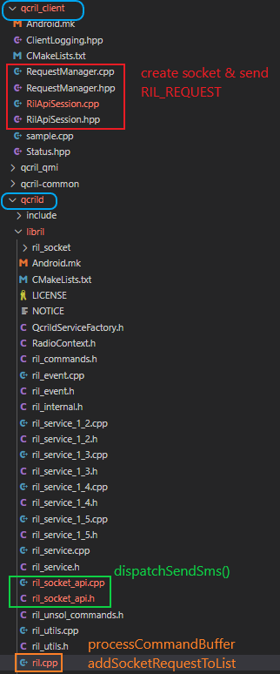
QCRIL Client vs QCRILD

Slide 29
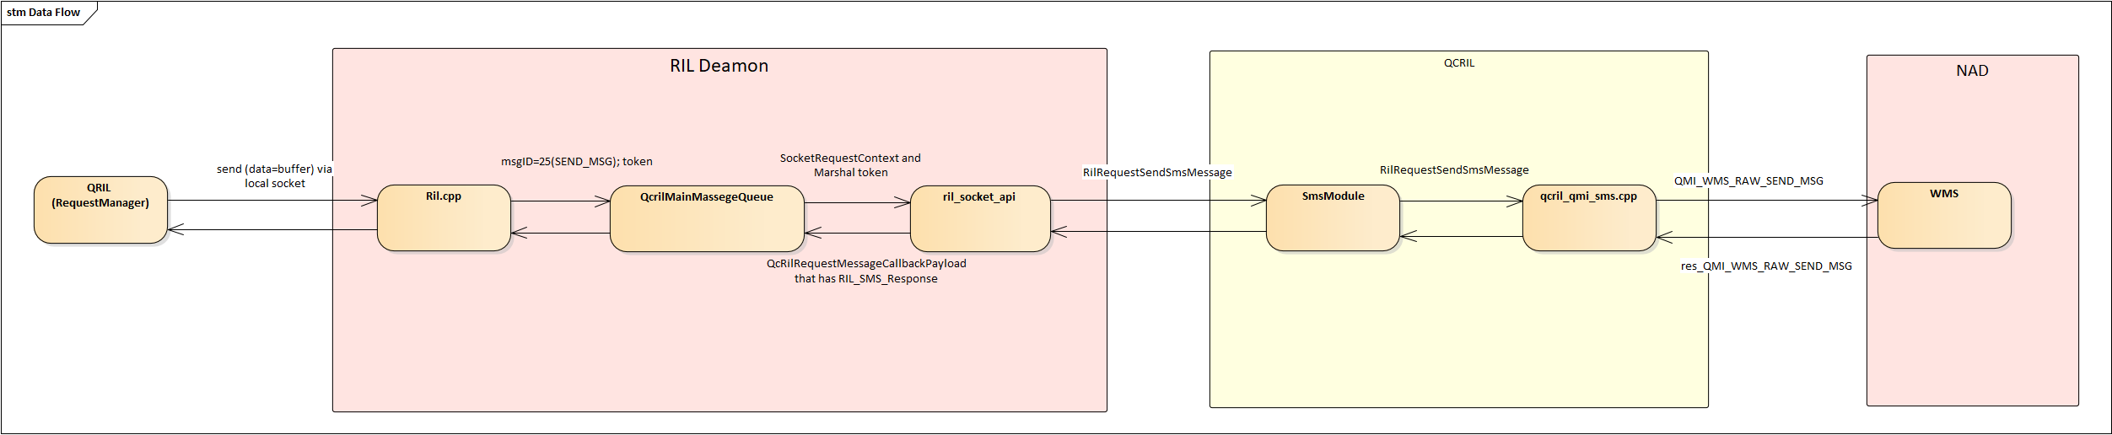
Data Flow QCRILD <-> QCRIL
Data flow represents the input arguments for main API that were called at each module

Slide 30
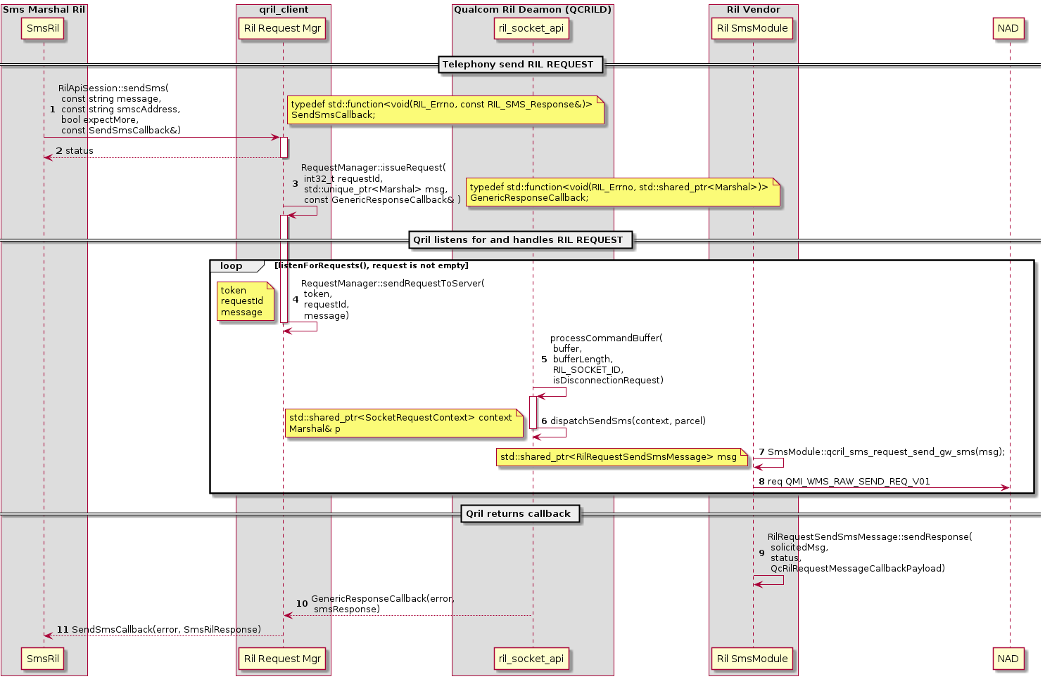
Sequence QCRIL Client → Ril Daemon (RILD) → Ril Vendor (QCRIL)→ Modern (NAD)

Slide 31
Explaining functions
Step 5: ril.cpp::processCommandBuffer()
 | descriptions
input | void *buffer, size_t buflen, RIL_SOCKET_ID socket_id bool& isDisconnectionRequest
output | requestID = *(reinterpret_cast<int32_t*>(buffer)); Marshal packet = setData(std::string(reinterpret_cast<const char*>(buffer) + requestParameterParcelOffset, buflen - requestParameterParcelOffset));
destination | call ril::socket::api::dispatchSendSms(context, p);
return | 0 always
 | descriptions
input | std::shared_ptr<RilRequestSendSmsMessage> msg
output | QMI request message: wms_raw_send_req_msg_v01 that has the following fields: smsc-Address length message format raw message[]
destination | NAD
return | void function.
Step 7: qcril_sms_request_send_gw_sms(

Slide 32
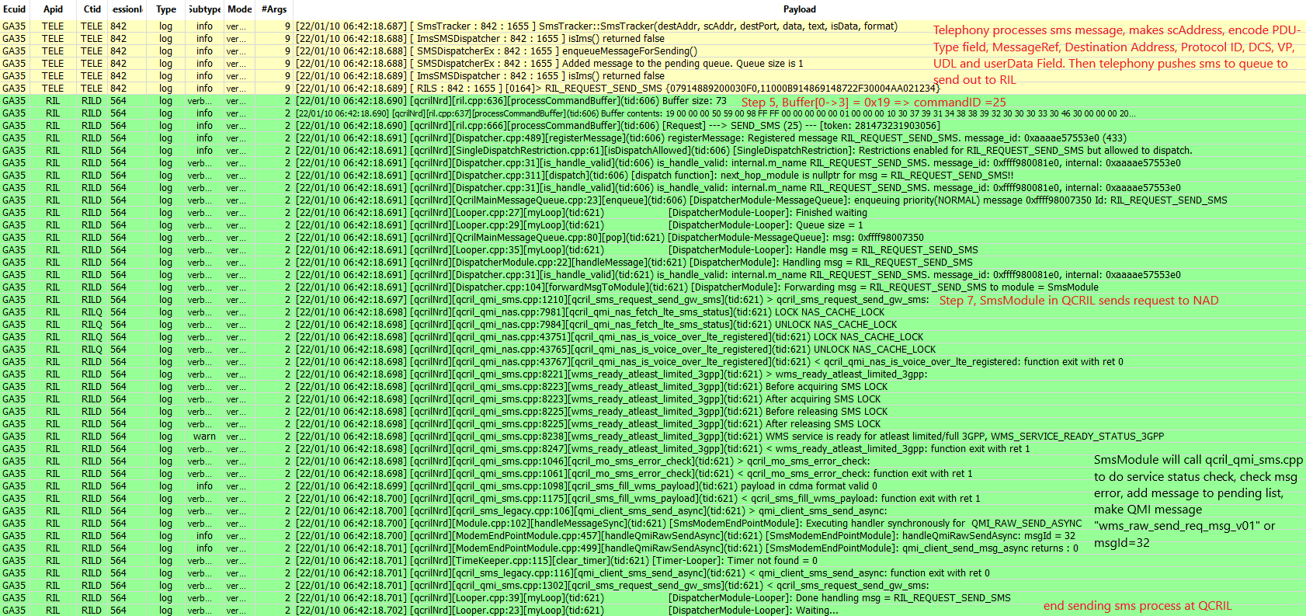
RIL Log Reading

Slide 33
Telephony Log Reading
After QCRIL sends QMI message to NAD
After RIL returns response, Telephony processes the remaining SMS message in queue to send out:

Slide 34
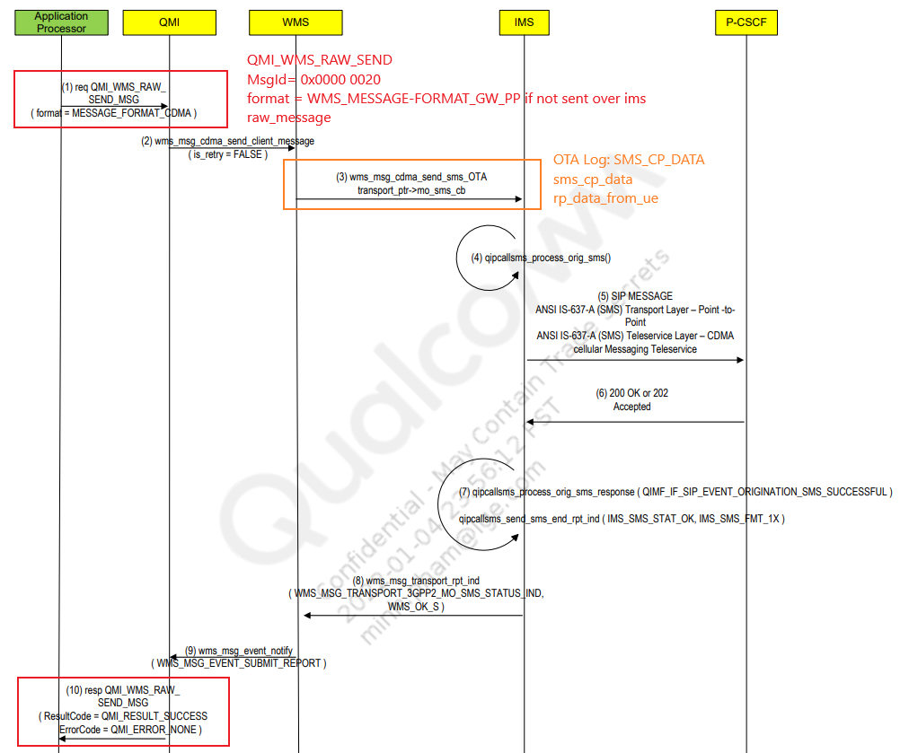
QMI Messages

Slide 35
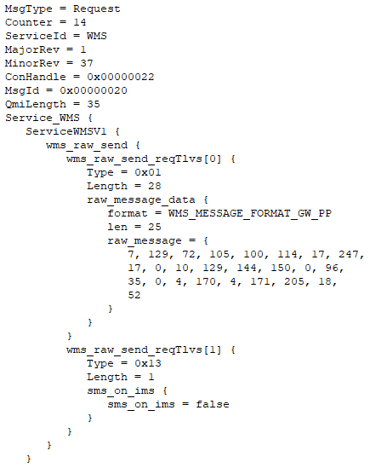
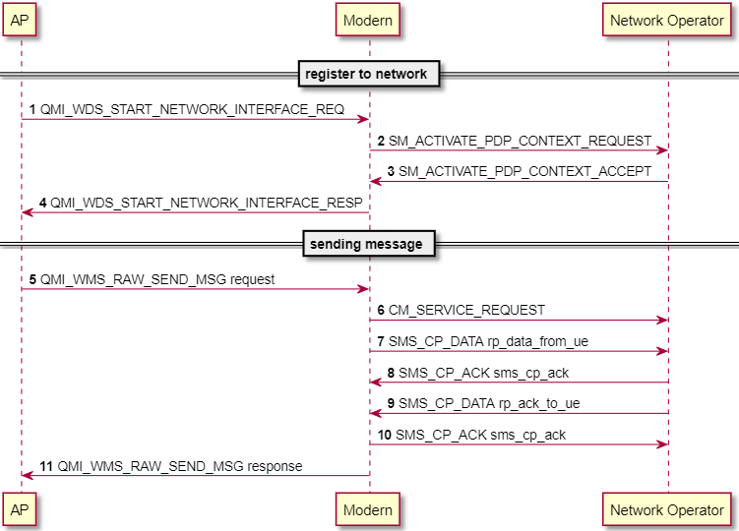
NAD Log reading – QXDM
QMI messages are defined by: Qualcomm document 80-PT830-9 Rev. D

Slide 36
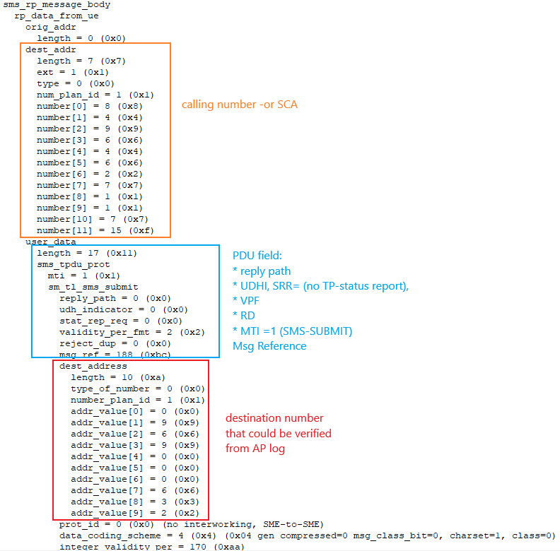
NAD Log reading – QXDM (T.B.D)

